Slide 1
Accounting for Canada’s Natural Capital:
Introducing the Natural Capital Protocol

Slide 2
Housekeeping
Please type any questions you have and they will be discussed during the webinar or at the end during the Q&A session.
All participant microphones will be muted during the presentation. If specific questions require follow up from the audience, the presenters will un-mute microphones as required.
A series or survey questions presented during the webinar. Please respond to questions using the polling platform in the Go To Meeting.
You may live tweet during the webinar @NaturalCapLab.

Slide 3
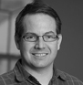
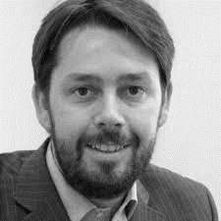
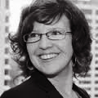
Presenters
John Purkis
Director,
Natural Capital Lab
Mark Gough
Director,
Natural Capital Coalition
Geneva Claesson
Senior Manager,
Sustainability and Climate Change, Deloitte
Notes:
John to welcome people and introduce our speakers:Name, organization, Why is natural capital important to you?
Mark Gough is the Executive Director of the Natural Capital Coalition, a role he took on in March 2015. A strong believer in integrating sustainability into decision making where it becomes everyone’s opportunity, Mark previously worked for The Crown Estate, helping to develop its integrated vision and approach to value measurement. Prior to this he was the Global Environmental Manager for the information company, Reed Elsevier. Mark is a Director of the Aldersgate Group, which brings together business, politics and civil society to drive action for a sustainable economy, and has sat on a number of national and international committees, including the Steering Committee of the United Nations CEO Water Mandate and the Board of the Alliance for Water Stewardship.

Slide 4
Agenda
Today’s webinar will provide an overview of the Natural Capital Lab and how you can participate in this national initiative intended to improve and transform the way
Canadian organizations measure, manage, and make decisions about natural capital.
Item | Presenter | Time allocation
Welcome and Introductions | John Purkis | 10 mins
The Natural Capital Protocol | Mark Gough | 20 mins
Deloitte’s Role in Natural Capital | Geneva Claesson | 10 mins
Q&A | All | 20 mins
Notes:
John to cover the agenda.

Slide 5
Survey question 1
What is your background?
Finance/Accounting
Law
Environmental Science
Engineering
Economics
Social Science
Other
Notes:
What is your background?
Finance/Accounting
Legal
Environmental Science
Engineering
Economics
Social Science
Other

Slide 6
Survey question 2
Is your organization currently working on or planning to work on a natural capital project (e.g., pilot the natural capital protocol or similar, Internal training, etc.?)
Yes
No
Notes:
What is your background?
Finance/Accounting
Legal
Environmental Science
Engineering
Economics
Social Science
Other
Transfer to Mark’s slides
Questions:
Who is on the call (sectors, regions, etc.)
What are your skills related to natural capital?
Is your organization currently working on or planning to work on a natural capital project (e.g., pilot the natural capital protocol or similar, Internal training, etc.?)

Slide 7


Slide 8
What is the problem and how will NCL help solve it?
Canada’s Natural Capital is being eroded at a rate
that threatens our future wealth and prosperity.
Canada has demonstrated excellence in Natural Capital research (ie Stats Can) and practice (ie forestry) that is not being broadly applied.
The Natural Capital Lab will catalyze a movement to build the field, amplify existing efforts, and innovate new ones
So that Canada will become a leader in Natural Capital stewardship
Society has always rested on its oldest capital. We think of produced capital as the original capital against which we compare natural capital, but the original stuff is natural capital.
- NCL workshop participant

Slide 9
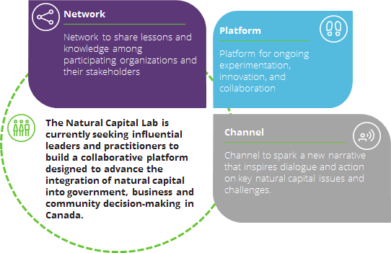
Overview of the Natural Capital Lab
Notes:
Geneva/John
Speaking notes:
John – could provide brief background on the Lab to-date (e.g., Phase I outcomes)
The Natural Capital Lab (NCL) is being co-convened by The Natural Step Canada, CPA, TD Bank Group, The Cooperators, Deloitte, Sustainable Prosperity, and the Municipal Natural Asset Initiative.
Geneva – could speak to the vision and objectives.

Slide 10
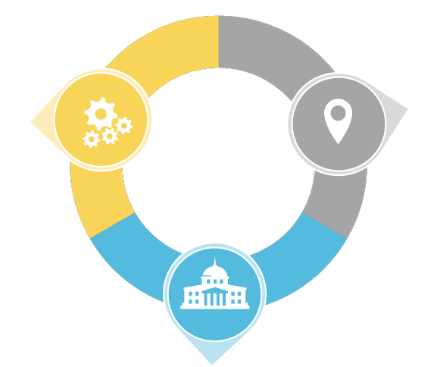
Sector-based work streams
Natural Capital Innovators will participate in one of three sector-based work streams, who will define a collective vision, transition strategy, mandate, and innovative solution(s) to prototype and pilot.
Corporate
Municipal
Collaboration across companies and associations to improve natural capital training, management and reporting, primarily in resource intensive sectors such as mining, oil and gas, agriculture, and consumer business
Collaboration across municipalities to understand natural capital assets and develop tools to measure and manage natural capital
Federal and Provincial/Territorial
Collaboration across government agencies focused on developing systems of accounts and policy instruments to incent improved natural capital management practices
Notes:
Geneva

Slide 11








is powered by
in collaboration with our Founding Partners and Funders:
Notes:
We’re not doing it alone.
Today we are pleased to have Mark Gough provide an overview of the new Natural Capital protocol.

Slide 12

Natural Capital Protocol
@NatCapCoalition #NatCapProtocol
Notes:
MG

Slide 13
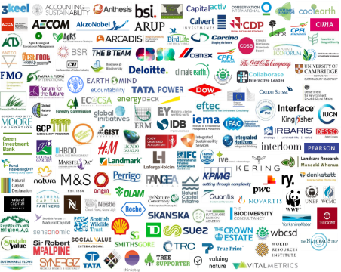
Who makes up the Coalition?
Putting the puzzle together
Policy
Membership
Organizations
Conservation bodies & NGOs
Standard Setters & disclosure
Business
Science and academia
Finance
The Coalition is purpose
driven, bringing together a
wide range of stakeholders who agree to collaborate on activities to help create a world where business conserves and enhances natural capital.
Notes:
MG
215 Coalition Organizations as of September 2016.
The Natural Capital Coalition brings together the different initiatives and organisations working in natural capital to collaborate on projects that will help to deliver a common vision of a world where business conserves and enhances natural capital. www.naturalcapitalcoalition.org
Our theory of change
No individual organization will solve the enormous problems we face by itself, and it is only by working together that we will find the solutions we need. The sum is greater than the parts.
These members covers what we have defined as seven stakeholder groups.
Conservations and Not-for-profit, who provide the why?
Research (science and academia), who provide the information
Business, who can provide solutions
Membership organisations who share best practice and develop tools
Standard setters who help to align information and define reporting requirements
Finance which provides the oil for change.
Policy (Government, advisors and policy makers) who help create an enabling environment.
You will see all of those represented here and this is the strength of the Coalition. It is not a business group for business. It is truly collaborative, and all of the Coalition organizations are working towards the same vision of a World where business conserves and enhances natural capital.
The Coalition has a range of projects that it is running through it members, including the Protocol, Sector Guides, Enabling Environment and Outreach

Slide 14
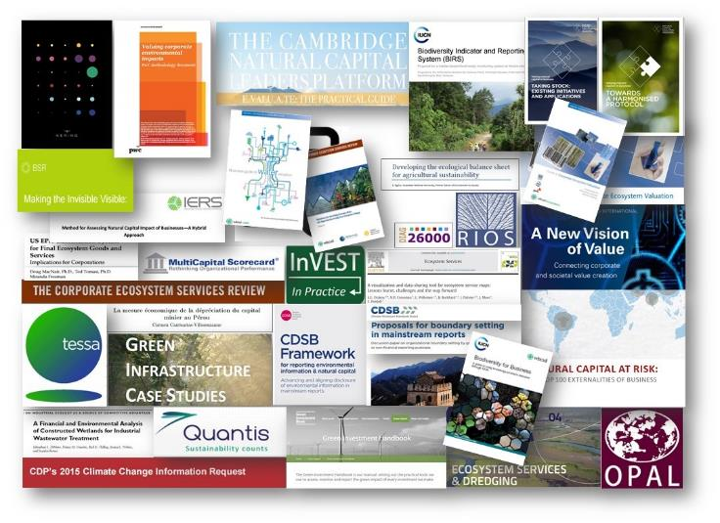
Harmonization
There are many different approaches to natural capital and a lot of work has been carried out already. The Natural Capital Protocol standardizes this into a single global framework
Notes:
We can see from the small example on this slide, the wealth of intellectual content and tools and approaches that already exist in the natural capital field.
This highlights the need for standardization, and a process into which all of these existing resources can input. It is important to note that the Natural Capital Protocol does NOT aim to recreate or invent any new methodologies – instead the aim is to leverage what we have already alongside the Protocol’s generally accepted framework.
Again, this highlights the value of having so many of the organizations on this slide, working together on the development of the Protocol.
We are especially delighted that, during this past year of Protocol development, two previously proprietary methodologies – from PwC and Kering – have also been made publically accessible. Again, opening the field up to more collaborative advancement and innovation.

Slide 15




































A unique collaborative process
Developed the Protocol
Developed the sector guides, and managed the business engagement and pilot testing
The Coalition is hosted by ICAEW.
Notes:
Many of the Coalition members have come to together to develop the Protocol and Sector guides, as you will see here. The WBCSD consortium led on the writing of the Protocol and the IUCN consortium led on the engagement process. It is a unique arrangement, where a group of organisations have come together and under contract have agreed to deliver something for the public good.
The diversity of opinion brings great value to the discussion and there is considerable strength behind the results when everyone agrees.

Slide 16
We asked business what they needed
80+ businesses from 15 sectors and all geographic regions
    8
    Adoption Factors
    6
    Primary Uses
    4
    Benefits
Accessible
Flexible
Aligned
Credibility
Relevance
Comparable
Decision-useful
Unlocks value
Strategic planning and decision making
Supply chain risk-assessment
Capital allocation
Investment decision making
Operational decision making
External reporting
Improved risk management
Better decision making
Increased competitive advantage
Balanced and comparable reporting
Establish a clear framework that is…
...that conveys…
...and drives meaningful results…
Notes:
Covering 15 sectors and all geographic regions, it is the largest study of this kind that I am aware of and it produced some interesting results.
It highlighted eight key factors that could drive uptake of the Protocol, six primary intended applications and four main areas of anticipated benefits and These have helped structure our thinking thus far and fed into the development of the Protocol framework that is being launched online today.
Coming out of the adoption factors was a drive for decision usefulness and value creation, but on top of this was a clear need to engage with the senior leaders. We are therefore going to be producing a CXO guide alongside the Protocol to help to address this and will be using our newly formed Coalition forum of senior leaders to help inform the development of this.
With the Primary uses, it was interesting to note that even though we include it here, very few highlighted external reporting as important at this time and felt that we were still several years away from that.
With the Benefits, this covered reducing risks, improving decisions, creating opportunities and keeping up with the competition.

Slide 17































Leading companies tested the draft Protocol
Over 50 businesses contributed to the Protocol piloting program
Deep Dives
Piloted the entire Protocol
Piloting companies
Piloted different steps of the Protocol

Slide 18
Natural Capital Protocol

Slide 19

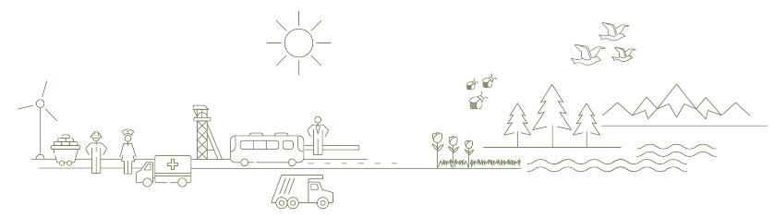
Introducing the Protocol
The Natural Capital Protocol is a
standardized framework for business
to identify, measure and value its direct and indirect impacts and dependencies
on natural capital
Notes:
The Natural Capital Protocol is a standardized framework for business to measure and value its direct and indirect impacts and dependencies on natural capital and is:
1. Internationally applicable, across all business sectors, geographies and organizational levels (e.g. corporate, project, product).
2. Leverages existing approaches and does not prescribe the use of specific methodologies or valuation techniques above others as the use of the Protocol is dependent on the intended application and context.

Slide 20
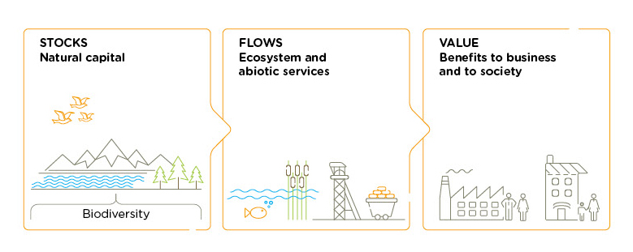

Definitions
The Natural Capital Protocol is a
standardized framework for business
to identify, measure and value its direct and indirect impacts and dependencies
on natural capital
The stock of renewable and non-renewable natural resources (e.g. plants, animals, air, water, soils, minerals) that combine to yield a flow of benefits to people

Slide 21
Definitions
The Natural Capital Protocol is a
standardized framework for business
to identify, measure and value its direct and indirect impacts and dependencies
on natural capital
Internationally applicable across all business sectors, geographies and scopes; leverages existing approaches

Slide 22
Definitions
The Natural Capital Protocol is a
standardized framework for business
to identify, measure and value its direct and indirect impacts and dependencies
on natural capital
Aimed at informing business decision making with trusted, credible and actionable information

Slide 23
Definitions
The Natural Capital Protocol is a
standardized framework for business
to identify measure and value its direct and indirect impacts and dependencies
on natural capital
To measure: determine the amounts, extent and condition of natural capital, in physical terms, e.g. m3, tons
To value: estimate the relative importance, worth, or usefulness of natural capital to people / business, in a particular context. Can be qualitative, quantitative or monetary

Slide 24
Definitions
The Natural Capital Protocol is a
standardized framework for business
to measure and value its direct and indirect impacts and dependencies
on natural capital
Impact: negative or positive effect of business activity on natural capital
Dependency: A business reliance on or use of natural capital

Slide 25
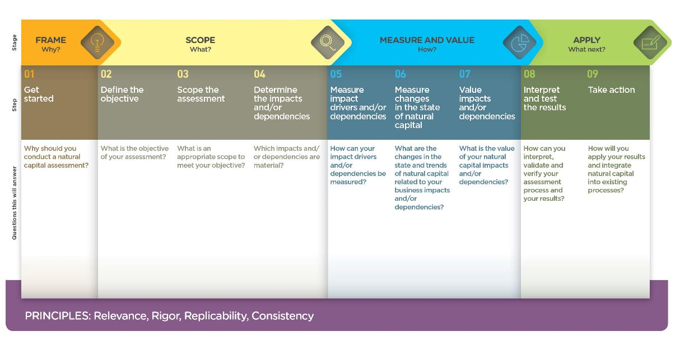
The Natural Capital Protocol Framework
Notes:
The Protocol therefore is based around a simple framework
4 overarching stages of frame (why), scope (what), measure and value (how) and apply (so what) and 09 logical steps. It should be easy to follow and should be suitable for any business across any sector or geography. The sector guides will allow for difference in materiality and focus.

Slide 26
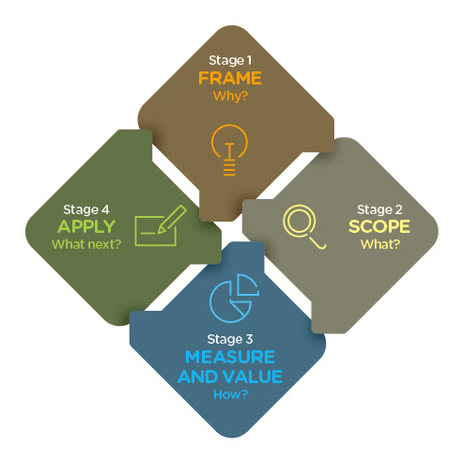

The Stages are connected and iterative
Notes:
In the previous diagram the Framework you will note is linear, for ease and simplicity.
Of course in practice, these stages all interconnect and iterate at points. We didn’t want to give the impression of an endless cycle that may be hard to break out of, but instead a flexible and adaptable process to meet your business’ objective.
For example, in preparing to measure and value you may realise that you will need to reduce your scope to cover either impacts or dependencies to start with, and would therefore need to revisit the scoping in Stage 2.

Slide 27
Sector Guides

Slide 28



Which sectors?
Protocol
The Coalition will develop new guides in partnership with sector initiatives and associations
Under development:
Real Estate
Finance Sector Supplement
Food & Beverage
Apparel

Slide 29

What does this look like in practice?
The sector guides follow the Protocol framework exactly and do not introduce any additional Stages or Steps
The sector guides provide additional guidance on the actions within each Step that are most relevant to the sector
As such, the sector guides should be used alongside the Protocol rather than in isolation

Slide 30
Primer and business case

Slide 31

Primer
A short introduction to the Natural Capital Protocol and sector guides
Sets out why applying the Protocol and including natural capital in your considerations will improve decision making
Notes:
It includes
the business case
Those that have piloted the Protocol
Definitions
The framework
Who the Protocol is for
And who wrote it

Slide 32
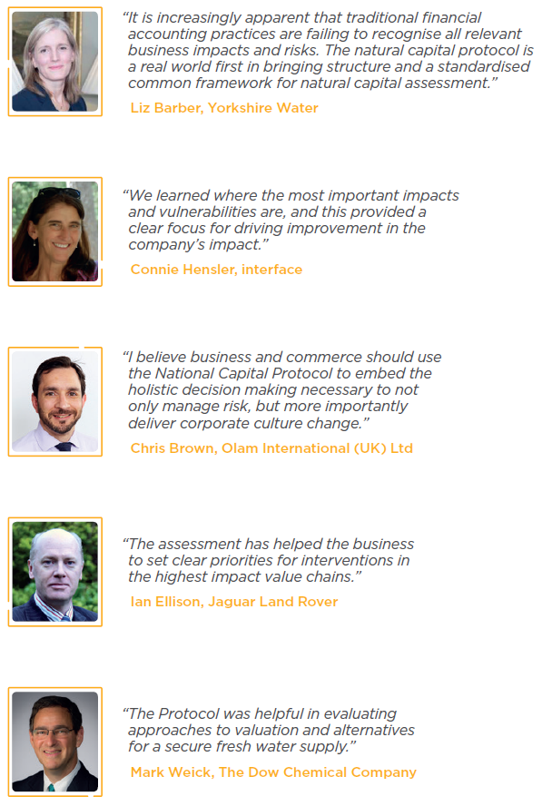
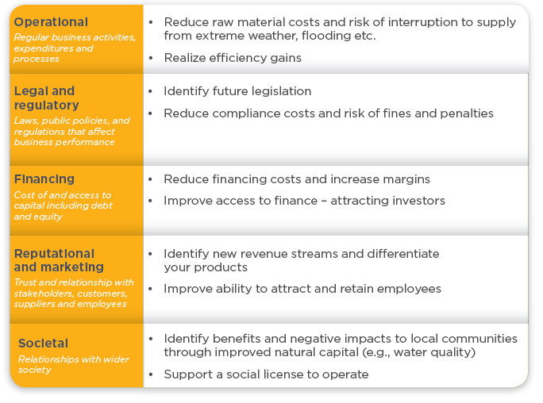
The business case

Slide 33
The Landscape

Slide 34
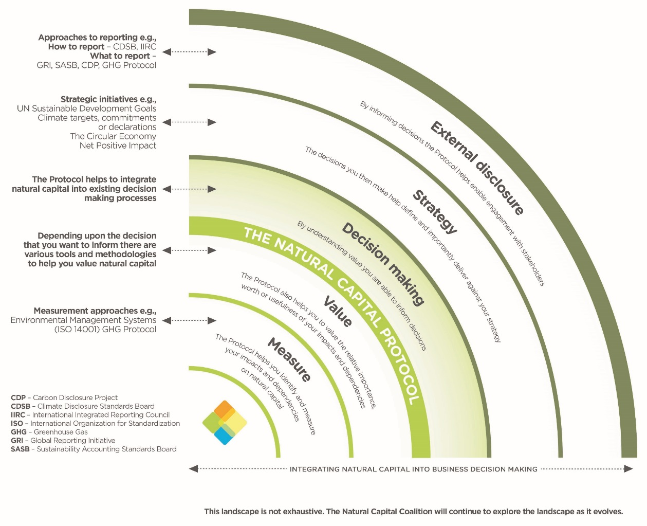

Slide 35
Application

Slide 36



Decision we wanted to influence:
  Enhance the business model for Indian sugar production
Business application:
  Compare options
  Assess impacts on stakeholders
  Estimate total value and/or net impact
Impacts and dependencies:
  Climate change
  Natural Capital (land, water, soil)
  Farmers
  Sugar mill
Business boundaries:
  Product
Material issues:
  Productivity
  Water
  Soil
  Temperature
Methodological approach
  Quantitative, qualitative and monetary
Result
  Farmer productivity h28%
  Water use i28 billion litres
Integrated in the business

Slide 37
Shell’s Natural Capital Protocol pilot
Water Valuation
Methodological approach:
  Sustain Value & PwC developed initial method
  Private cost – Ave cost/m2
  Private value – Effect on production & replacement cost/m2
  Public value – Total economic value using value transfer /m2
Result:
Integration in the business:
  Helping inform different assessments:
  Opportunities for efficiencies
  Scope for reducing impact on public values
  Screening of future projects based on water cost and value
  Asset resilience to
  increased water cost
  Regulation risk assessment
Decision Shell wanted to influence:
  Test if accounting for NC can lead to reduced business risk, enhanced growth and improved return on investment
Business application:
  Assess risks & opportunities
  Communicate internally
Impacts and dependencies:
  Value of water in catchment & downstream (i.e. value at at risk)
  Water dependency
Business boundaries:
  Direct operations – 2 downstream assets
Material issues:
  Water (and associated values e.g. angling, property values, biodiversity)

Slide 38

Protocol Application Program
The Program aims to encourage the uptake of the Protocol by business, providing support, materials and shared learning to those applying it
To join the Protocol Application Program go to
http://eepurl.com/b4YjN1
The Protocol Application Program will be led by CISL on behalf of the Coalition

Slide 39
The Natural Capital Hub

Slide 40
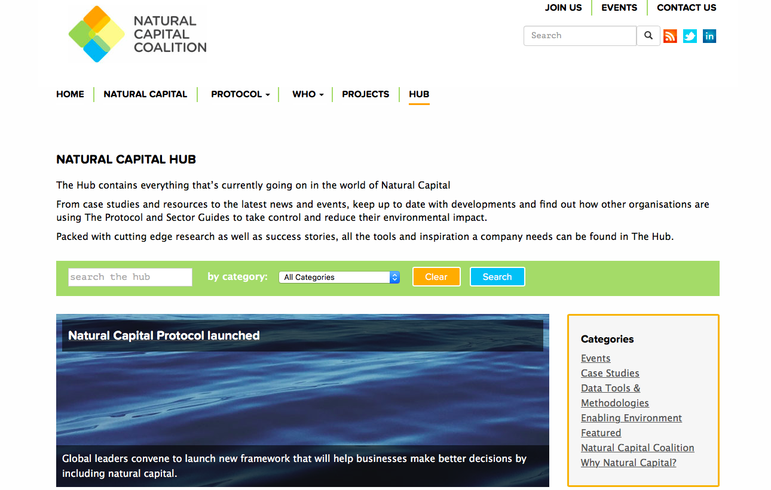
Natural Capital Hub
Providing a link to everything natural capital
270 content pieces and growing on a searchable database including events, case studies, news stories, white papers and much, much more.

Slide 41
www.naturalcapitalcoalition.org

Slide 42

Notes:
Geneva’s slides on Deloitte

Slide 43
Deloitte’s role in the Natural Capital Lab
Deloitte is a proud Founding Partner of the Lab, and we are involved in various ways.
How Deloitte is engaged
Funder
Facilitator
We support the Natural Capital Lab because natural capital accounting is essential for creating long-term value, and solving tough problems needs collaboration.
Why Deloitte is engaged
We are committed to helping our clients make a positive impact in markets and communities
We bridge the gap and translate natural capital into commercial terms
We provide access to the C-suite and deliver messages that resonate with CFOs
As a facilitator, we have the opportunity to work with innovators and leaders to shape and contribute to the emergence of natural capital accounting in Canada.
Advocate
User
We advocate the value of natural capital accounting to our clients around the world, and we use our network of over 1,200 sustainability professionals to generate momentum and interest.
As a professional services firm, we see opportunities for incorporating natural capital accounting into our services and how we manage our firm’s impacts.

Slide 44
Deloitte’s involvement in natural capital accounting and management
We support the lab with strategic insights, collaborative spirit, and technical expertise for lab design and work stream pilots and prototypes.
Deloitte’s natural capital focus areas:
Corporate solutions
 | Conservation impact measurement/ conservation investing Natural capital program design and performance evaluation Establishing science-based targets for environmental performance
 | Natural Capital Protocol assessments Assurance of natural capital indicators Supply chain risk assessments
 | Multi-stakeholder conservation management projects Contribute to the Natural Capital Lab with The Natural Step Canada and other Founding Partners
 | Sustainability/ CSR report development Development of natural capital profit & loss statements* Integrated reporting assessment and development
Companies are increasingly developing science-based targets based on the 2ºC temperature threshold
Companies are redesigning systems and processes to incorporate natural capital into strategy, organizational structure, risk management, and management systems
YT
NT
NU
Companies are measuring and valuing the impacts and dependencies of their products and services
NL
Companies are applying new tools (e.g., NCP, InVest, etc.) to screen natural capital and understand economic valuation of asset portfolios
BC
AB
SK
MB
QC
Companies are engaging in multi stakeholder initiatives to pilot natural capital initiatives such as watershed management
ON
NB
Companies are producing ESG performance reports, and aligning to new standards such as the GRI, IIRC, and SASB
*Methodology under development
Notes:
Geneva Claesson

Slide 45
How can you get involved?
Notes:
Brief overview of NCL with focus on Innovation Forum and Natural Capital Innovators application.

Slide 46
Milestones and schedule
Natural Capital Innovators will be engaged on a number of up coming activities between August 2016 and June 2017
August
September
October
November
December
January 2017
June 2017
Lab Recruitment
Onboarding Webinar
Learning Journey
Application deadline (October 14, 2016)
NCL Innovation Forum (November 23-24)
Implementation Working Groups
Innovation Summit
Notes:
Geneva
Onboarding Webinar
Host three webinars structured around the innovation groups to introduce participants to each other, and orient them to the activities of NCL and allow participants to share current activities and projects with each other.
Announce partners.
NCL Innovation Forum (2 days)
Create a space for participants to develop new relationships, explore issues, challenges, priorities and potential research within and across each innovation group. Participants will identify shared needs and opportunities and craft a vision and transition strategy for NCL. They will also explore collaborative leadership capacities and practices.
Learning Journey and Collaborative Action
Each innovation group would participate in a learning journey (workshop, information exchange, training, trip, etc) to explore their focus area, develop relationships, explore issues and develop new insights. A summary of activities and insights will be prepared following each learning journey.
Implementation Working Groups
Each Innovation group will develop an implementation plan outlining the various activities, pilots initiatives, research, etc. required to move the group forward.
Innovation Summit
Innovation groups gather for a 1-2 day summit to share their work, review areas of overlap, identify new research activities, prototype initiatives, and other priorities.

Slide 47
Natural Capital Innovators
The participants – Natural Capital Innovators – will co-create and prototype programs and projects that support the transition to a future where Canadian businesses and governments account for natural capital in decision making.
Through a series of high-caliber workshops and learning journeys built upon best-practices in social innovation and collaboration, Natural Capital Innovators will:
Develop leading-edge knowledge and skills to collaborate, lead, and manage in an increasingly dynamic and complex environment.
Glean strategic intelligence and insights about the natural capital space from peers and system-sensing research.
Build a strategic and systems-level understanding of natural capital accounting, its players and inter-relationships.
Develop an influential and supportive network of dynamic change-makers committed to creating positive impact and tangible outcomes.
Play a critical role in a high profile initiative that will help protect and enhance Canada’s Natural Capital.
Notes:
Geneva
- Potentially include points about previous labs and outcomes
- Actions - How can we

Slide 48
Natural Capital Innovator application process
Natural Capital Innovators in the Natural Capital Lab will include: representatives of federal, provincial and municipal governments; the accounting, finance, manufacturing, and resource extraction sectors; First Nations; non-profits; academia, actuaries, and economists.
The NCL application form is available online: naturalcapitallab.com/natural-capital-lab-innovators-application-form/
Online applications close 5:00pm EST on Friday, September 24, 2016 and participants selected by October 14, 2016.
Membership in the Natural Capital Lab is not transferable.

Slide 49
Natural Capital Innovator commitment requirements
There are time commitment requirements as well as a commitment fee for Natural Capital Innovators.
Time commitment
  The time commitment will be 12-15 days over 12-14 months; it will include attendance at the Innovation Forum on November 23-24 and ongoing work on specific initiatives identified during the Innovation Forum.
Commitment Fee
  The commitment fee ranges from $2000 – $5000 and covers percentage of the overall cost of providing the Innovation Forum, workshops, learning journeys and other activities of the Natural Capital Lab
  A limited number of bursaries are available to cover the commitment fee.

Slide 50
Survey question 3
How would you like to engage in the natural capital space?
Apply as an Natural Capital Innovator
Stay informed (e.g., participate in webinars and social media, receive NCL newsletter etc.)
Contribute to research and provide technical support
Support the NCL and it’s initiatives as a financial sponsor
Other

Slide 51
Q&A
For more information please visit the NCL website: naturalcapitallab.com
Sign up for the NCL newsletter and follow NCL on Twitter @NaturalCapLab to remain engaged and informed on the
Lab’s activities: naturalcapitallab.com/newsletter
Thank you to our convening partners and funders!
Notes:
Are you interested in joining as a natural capital innovator?
Need more information,

Slide 53
Natural Capital Lab Phase One Summary
What we did:
Established a growing network of 100+ stakeholders
Conducted research including 50+ global & domestic interviews
Hosted workshop to refine research & explore interest in Phase Two
Presented at 4 industry forums generating connections & interest
Hosted Phase Two co-design session with partners & experts
Represented Canada at the global Natural Capital Protocol launch
Outcomes:
Mapped the system including stakeholders, initiatives, challenges & opportunities
Evaluated the value of Phase Two among workshop participants
Generated international & domestic connections and support

Slide 54
Natural Capital Lab Phase One Summary
Outputs:
Natural Capital Research Summary
Natural Capital Workshop Summary
Natural Capital Lab: Phase Two Overview
Support video – NCL Introduction
Developed Phase Two approach & solicit feedback
Reviewed Phase Two approach with partners & confirm funding
Recruited steering committee
Launched NLC web site
Created 2 new videos
We have resource industries and other actors making decisions about natural capital in various ways. It would be wise to get the scarcity signals associated with natural capital and ecosystem services well reflected within those management practices
- NCL workshop participant

Slide 55

CPA Canada’s involvement in sustainability and natural capital issues
Act in the public interest
Sustainable organizations that can preserve, enable or create value over the long-term, resulting in economic prosperity for Canadians.
Support our members
Contribute to economic and social development
Notes:
Speaking Notes:
CPA Canada’s mission is to act in the public interest, support our members and contribute to economic and social development.
To this end, CPA Canada and its legacy bodies have over 25 years of efforts in sustainability, including sustainability reporting.
We define sustainability as organizational activities that preserve, enable or create value over the long term.
This encompasses consideration of environmental, social and governance issues as part of overall strategy, risk management and reporting.
Sustainable organizations result in economic prosperity for Canadians.
Natural capital is critical to Canada’s economy, wellbeing and prosperity.
Natural capital is a logical extension of CPA Canada’s longstanding history in sustainability and it supports the achievement of our organization’s mission.
CPA Canada is committed to furthering the natural capital agenda in Canada. That’s why we are proud to be a core partner of the Natural Capital Lab in partnership with the Natural Step. We look forward to exploring opportunities with Canadian businesses to integrate natural capital considerations into their decisions, accounts and economic models.

Slide 56
CPA Canada’s role with the Natural Capital Lab
Business leaders need to expand their purview beyond the current financial landscape in order to truly integrate natural capital considerations into decision-making and strategy; a critical first step is engaging business leaders in the natural capital conversation.
The accounting profession is well-positioned to support all types of organizations in undertaking natural capital assessments and support business leaders in using this information to make more holistic, integrated and informed decisions about strategy and operational performance.
CPA’s…
Mitigate business risks
Evaluate assets
and liabilities
Measure and
manage resources
Develop business strategies
Notes:
Sarah Keyes
Speaking notes:
Delaying the measurement and management of natural capital poses significant business risks and could result in foregone opportunities for cost savings, competitive advantage and brand reputation.
Understanding the business risks and opportunities associated with impacts and dependencies on natural resources is essential for long-term value creation.
Organizations that fail to consider their impacts and dependencies on natural capital risk their ability to preserve, enhance and create long-term value.
CPAs are trusted advisors and strategists for organizations and natural capital is an area where we see tremendous growth potential in the future as the reporting landscape continues to evolve.
CPAs already have the necessary skills and competencies to support organizations in managing their natural capital impacts and dependencies – they simply need to apply these tools in a different context.
By virtue of these skills and competencies, CPAs have a tremendous opportunity to become leaders in natural capital accounting, supporting long-term value creation for organizations.

